Slide 1



Machine Learning
For Diagnosing Pneumonia

Slide 2
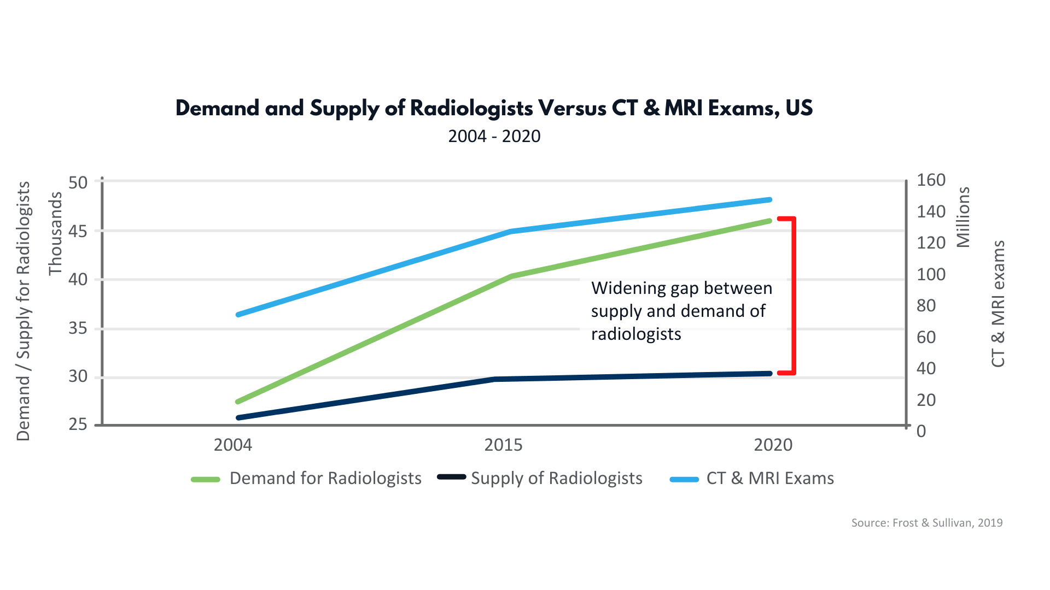
The Problem
Hospitals are overwhelmed by the amount of Pneumonia patients, with approximately 640,000 cases per year^{[1]}
Radiologists are in short supply and are needed to help interpret the results of X-ray images for patient treatment
Doctors need a way to quickly identify patients with Pneumonia, in order to develop a treatment plan for them
Source: vRad Blog Post by Raymond Montecalvo, MD

Slide 3

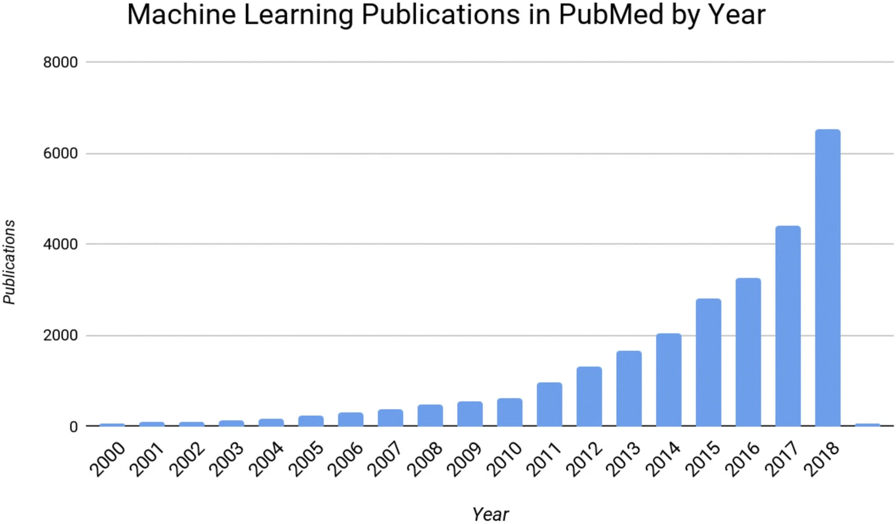
The Solution
A Machine Learning algorithm which can identify patients who have pneumonia would reduce the need for radiologists, decrease wait times for tests, and improve overall patient care
Interest in Machine Learning in medicine has rapidly grown throughout the years
This kind of algorithm requires a large amount of data in order to be trained correctly
Machine learning publications in PubMed by year through 2018^{[2]}
Source: Deep Learning and Neurology: A Systematic Review

Slide 4

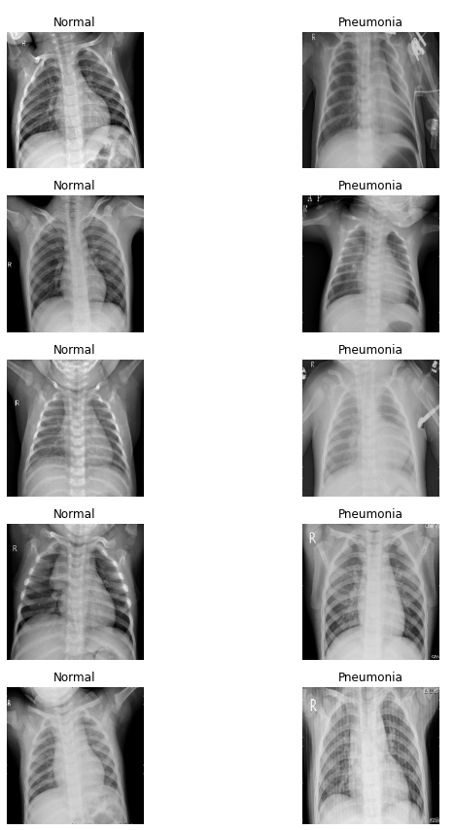
The Data
The images used to train this initial model comes from Labeled Optical Coherence Tomography (OCT) and Chest X-Ray Images for Classification by Daniel Kermany, Kang Zhang, and Michael Goldbaum
After removing duplicates from the data set, there were 4926 images that could be used to train the model along with 624 additional images for testing and validation of the model‘s results
This is a decent amount of data for testing the viability of a Machine Learning model for this purpose, however a practical model would require more data
Example Images from Training Set

Slide 5
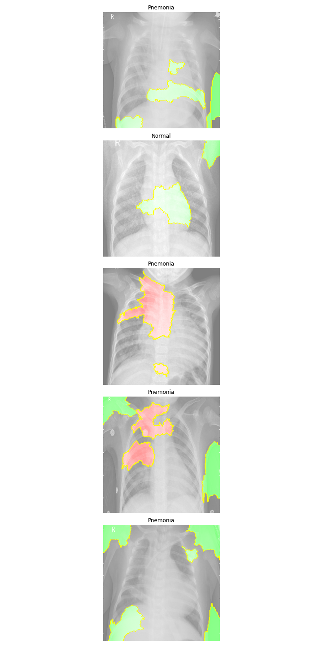
The Results
After training the model, a report was run to determine which areas of an image the model was evaluating in order to get the result.
Looking at the images to the left you can see areas indicating positive and negative correlation with a pneumonia diagnosis (green and red respectively)
You may notice that large areas of the indication fields are outside of the lungs
This indicates that there is a correlation on positioning of the patients during imaging, which will invalidate our model when used on other data

Slide 6
Conclusion
While the data provided had biases which would invalidate the use of the model on additional data, the proof of concept worked as intended with an 81% accuracy with 0 false negatives on the validation data set.
This means by training a model with a more widespread data set, we can eliminate the bias and improve our accuracy rate, leading to a tool which can assist hospitals in diagnosing and treating the eighth largest cause of death in the US^{[1]}
A formal request should be made to partnering hospitals interested in the implications of this research, asking for additional data to be used for this project

Slide 7
Sources
[1] Regunath H, Oba Y. Community-Acquired Pneumonia. [Updated 2021 Aug 11]. In: StatPearls [Internet]. Treasure Island (FL): StatPearls Publishing; 2022 Jan-. Available from: https://www.ncbi.nlm.nih.gov/books/NBK430749/
[2] Valliani, A.AA., Ranti, D. & Oermann, E.K. Deep Learning and Neurology: A Systematic Review. Neurol Ther 8, 351–365 (2019). https://doi.org/10.1007/s40120-019-00153-8

Slide 8
Any Questions?
For more information contact Wesley Giles at:
Wesley@Seraphdev.com

